Slide 1
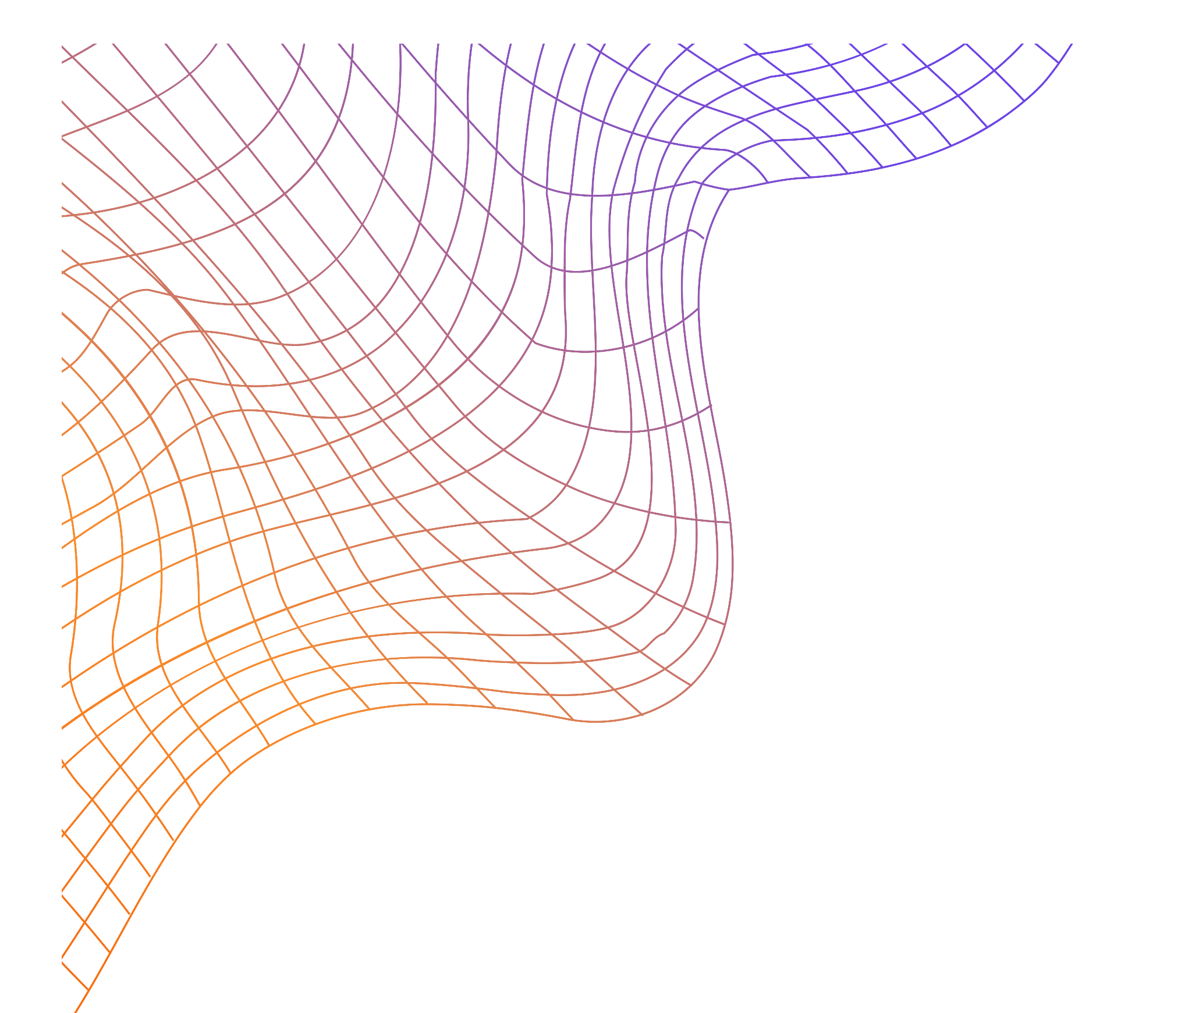
SAR Reduction
CIE 328
Under Supervision:
Dr. Bahaa Mahmoud Younes Eng. Nader Gamal
Eng. Manar Gebili

Slide 2
Table of contents
01.
02.
03.
04.
05.
06.
Introduction
Brain
Lungs
Heart
E-field Animation
Project factors

Slide 3
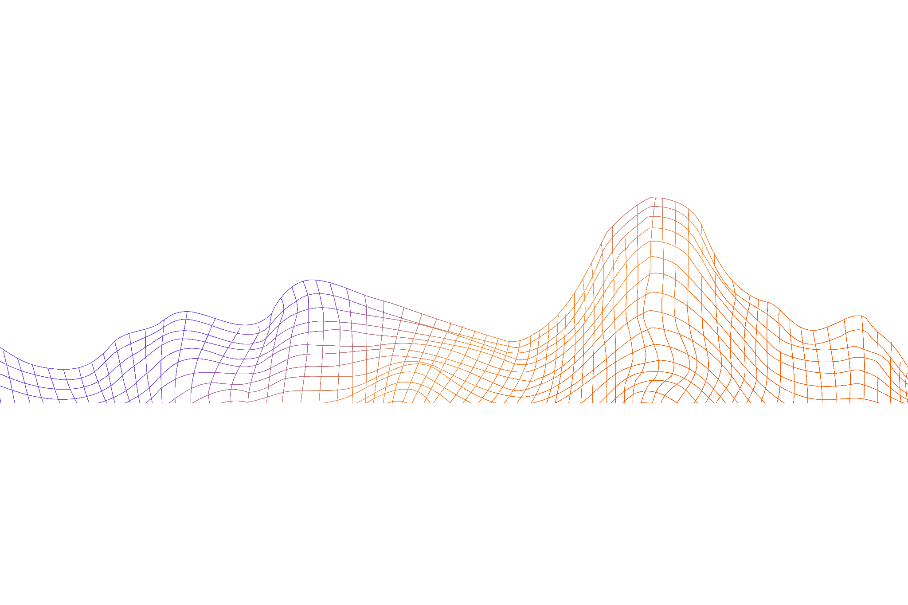
01.
Introduction

Slide 4
Our team and the distribution
Mai Abdelnaby
Brain
Fatma Mamdouh
Lungs
Mariam Mostafa
Heart

Slide 5

This project examines how electromagnetic plane waves, which are prevalent in long-distance communications such as those from power transmission lines, mobile devices, and Internet of Things (IoT) devices, interact with human body tissues (e.g., brain, lungs, heart). The study uses Computer Simulation Technology (CST) software to model these interactions, providing detailed simulations of wave propagation and absorption within different biological tissues.
By analyzing these interactions, the project calculates the Specific Absorption Rate (SAR), a critical metric that quantifies the amount of energy absorbed by body tissues when exposed to electromagnetic fields. The SAR results are evaluated in accordance with IEEE standards to ensure accurate assessments of wave exposure intensity.
The findings of this project can contribute to better understanding the safety implications of electromagnetic wave exposure and can guide the development of technologies and policies that minimize potential health risks.

Slide 6
02. Brain

Slide 7
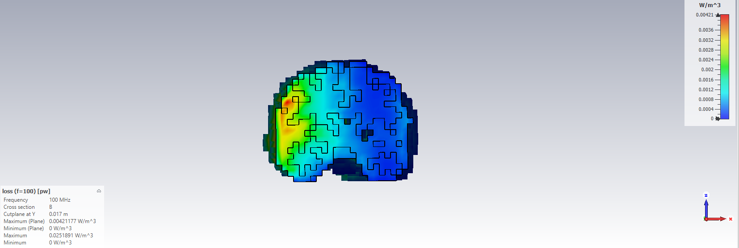
2-D SAR results for linear plane wave At angle 0
Fig. (1)

Slide 8
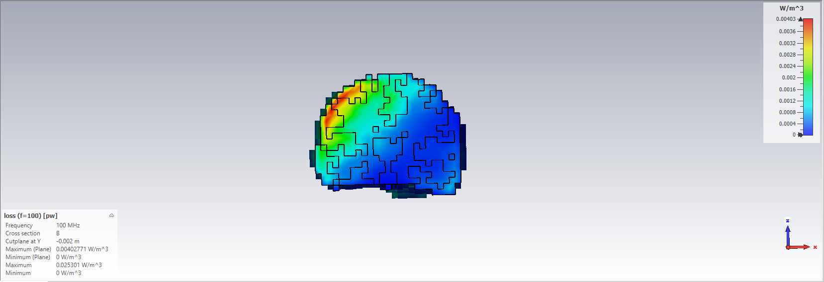
2-D SAR results for linear plane wave At angle 45
Fig. (2)

Slide 9
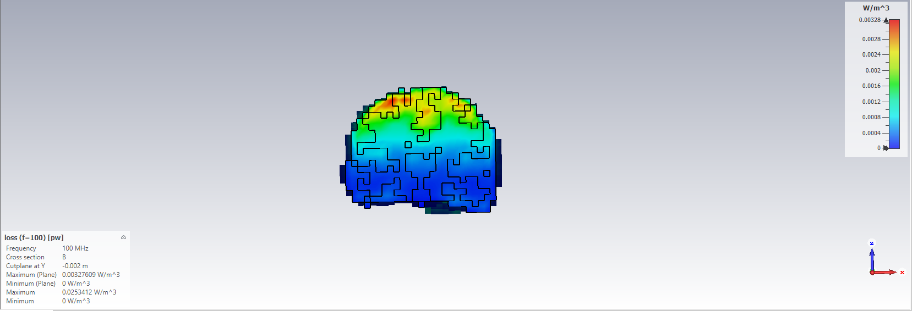
2-D SAR results for linear plane wave At angle 90
Fig. (3)

Slide 10
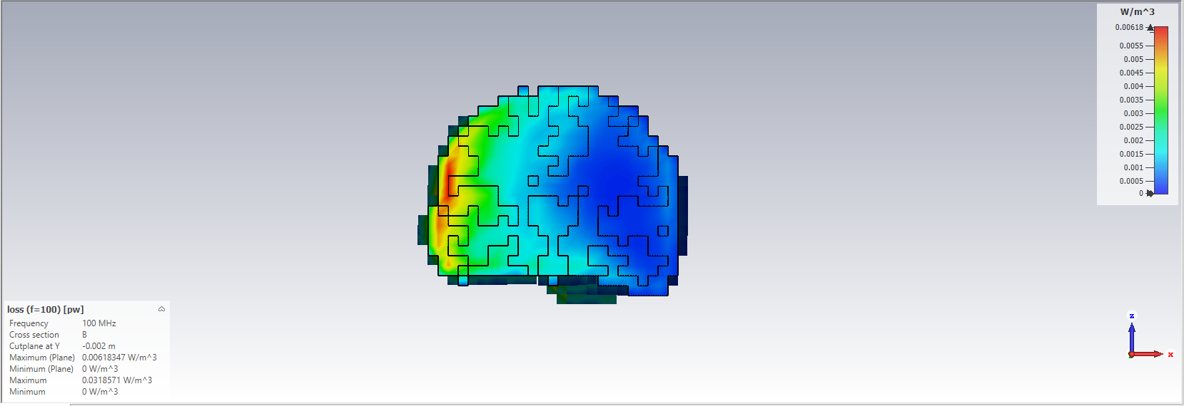
2-D SAR results for Circular plane wave At angle 0
Fig. (4)

Slide 11
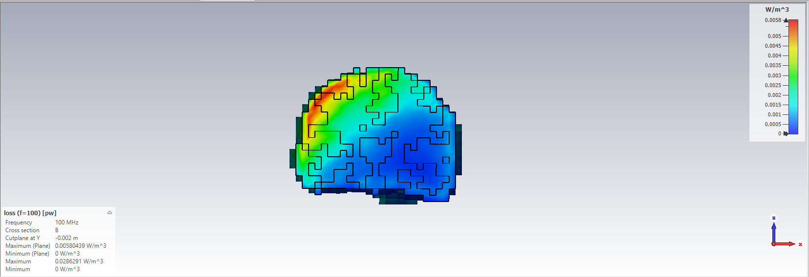
2-D SAR results for Circular plane wave At angle 45
Fig. (5)

Slide 12
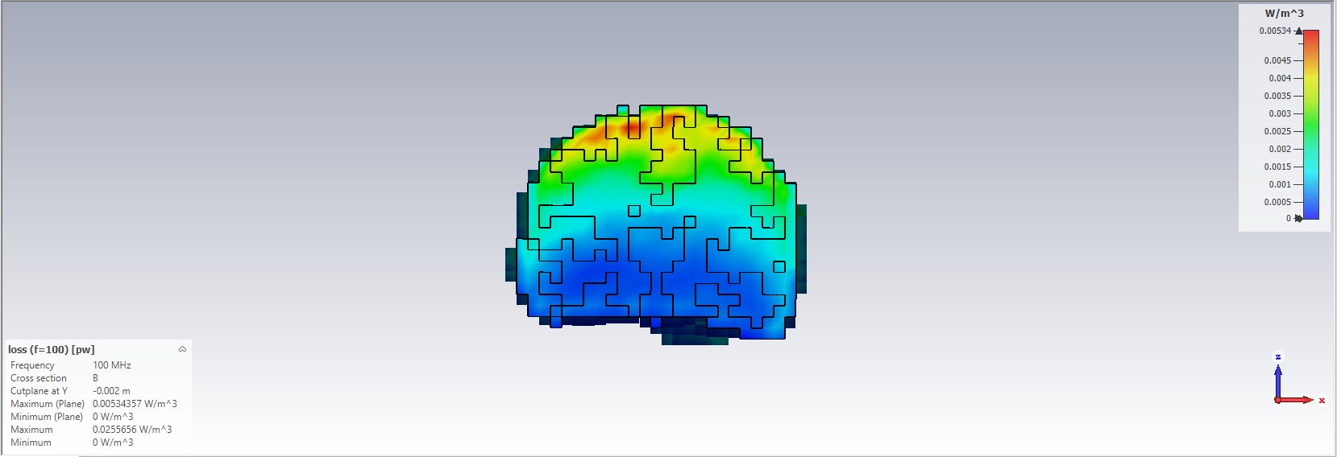
2-D SAR results for Circular plane wave At angle 90
Fig. (6)

Slide 13
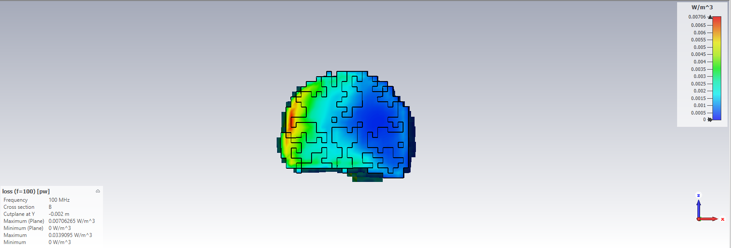
2-D SAR results for Elliptical plane wave At angle 0
Fig. (7)

Slide 14

2-D SAR results for Elliptical plane wave At angle 45
Fig. (8)

Slide 15
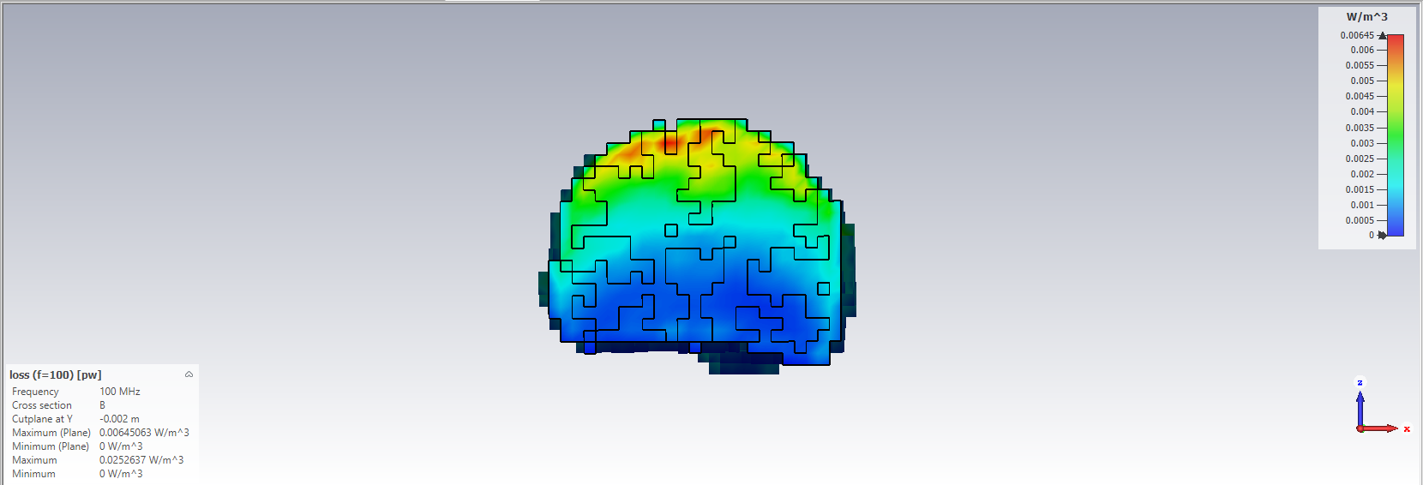
2-D SAR results for Elliptical plane wave At angle 90
Fig. (9)

Slide 16
03. Lungs

Slide 17
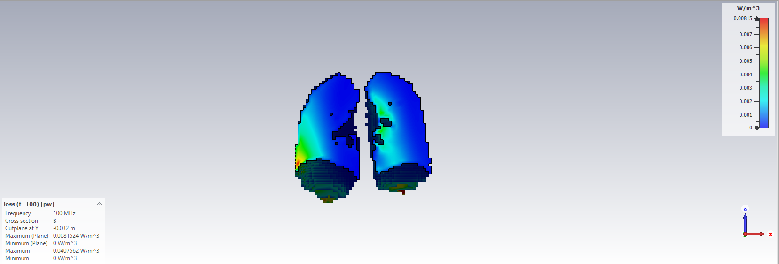
2-D SAR results for linear plane wave At angle 0
Fig. (10)

Slide 18
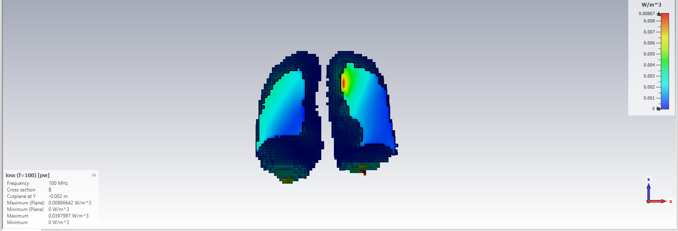
2-D SAR results for linear plane wave At angle 45
Fig. (11)

Slide 19
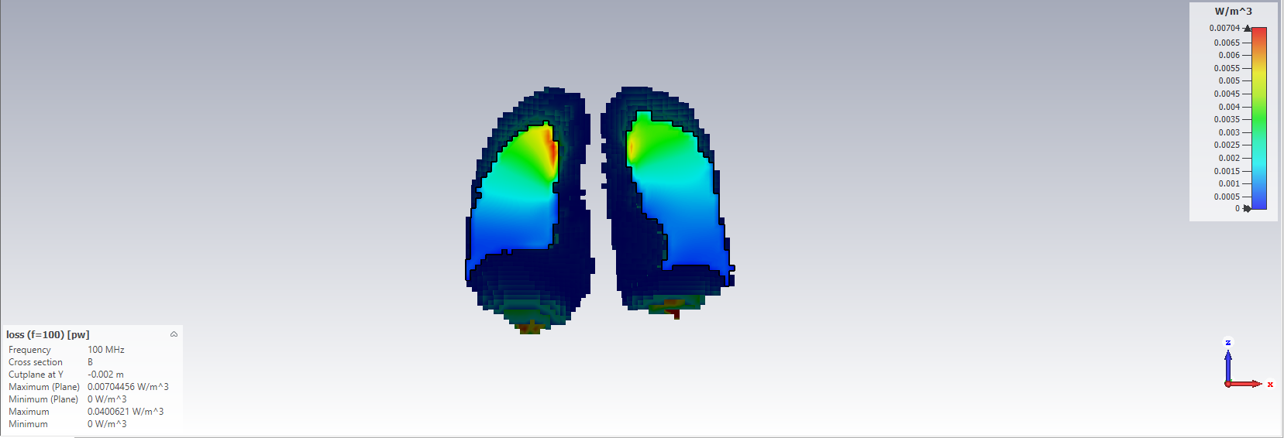
2-D SAR results for linear plane wave At angle 90
Fig. (12)

Slide 20
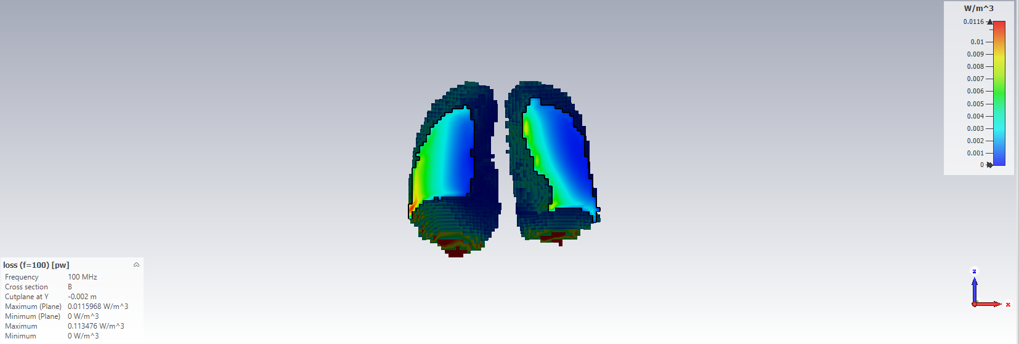
2-D SAR results for Circular plane wave At angle 0
Fig. (13)

Slide 21
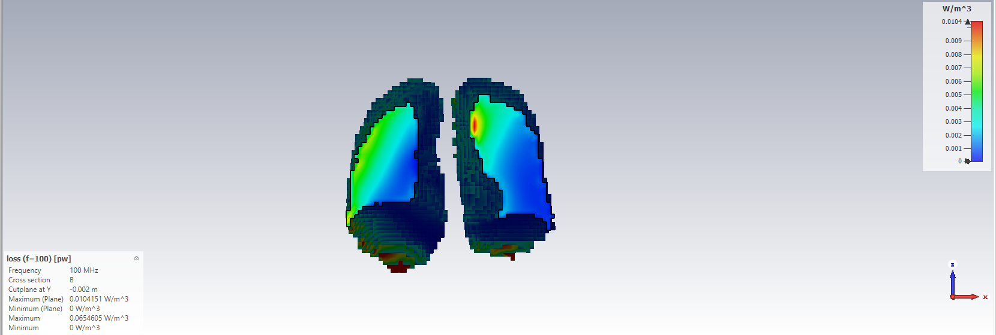
2-D SAR results for Circular plane wave At angle 45
Fig. (14)

Slide 22
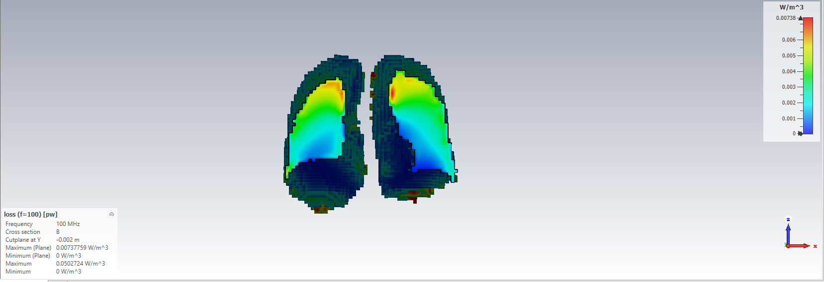
2-D SAR results for Circular plane wave At angle 90
Fig. (15)

Slide 23
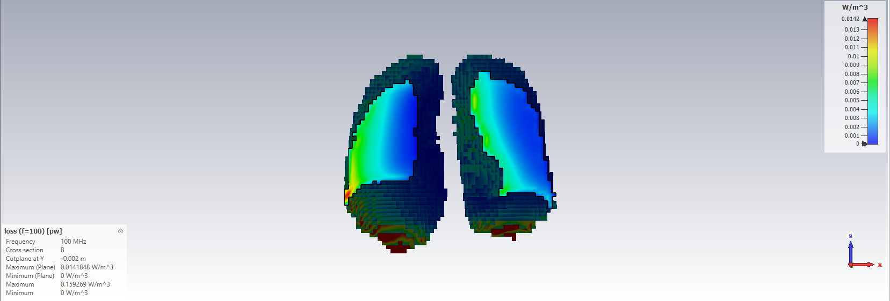
2-D SAR results for Elliptical plane wave At angle 0
Fig. (16)

Slide 24
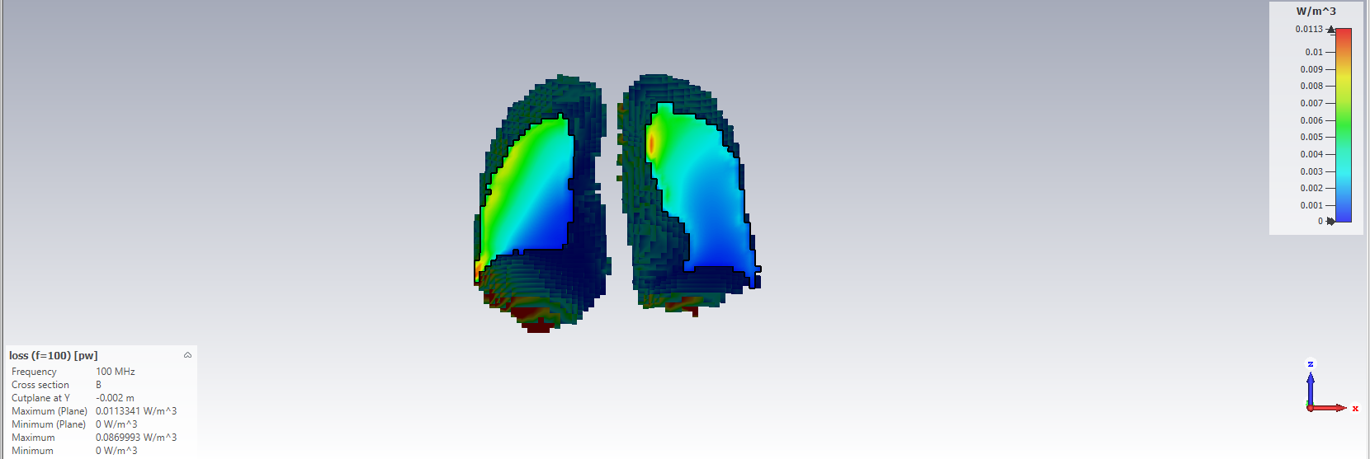
2-D SAR results for Elliptical plane wave At angle 45
Fig. (17)

Slide 25
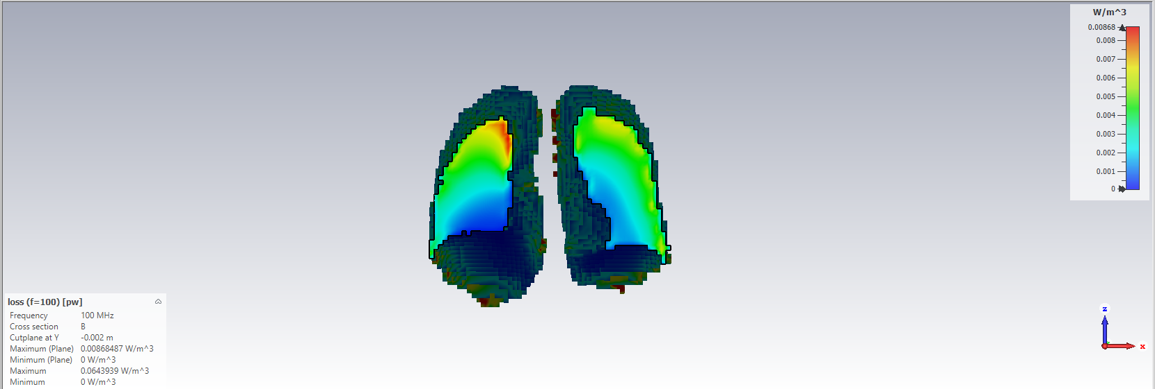
2-D SAR results for Elliptical plane wave At angle 90
Fig. (18)

Slide 26


04. Heart

Slide 27
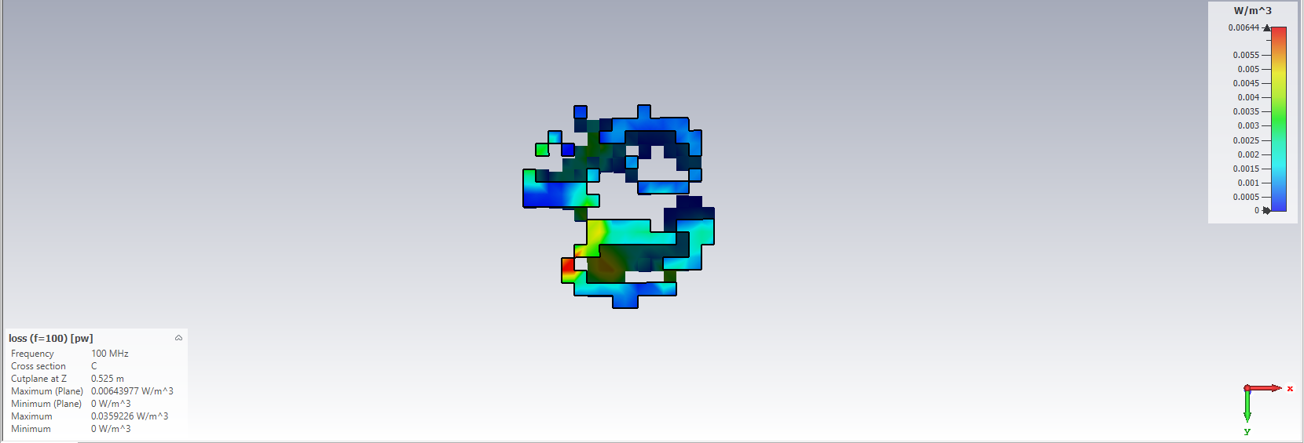
2-D SAR results for linear plane wave At angle 0
Fig. (19)

Slide 28
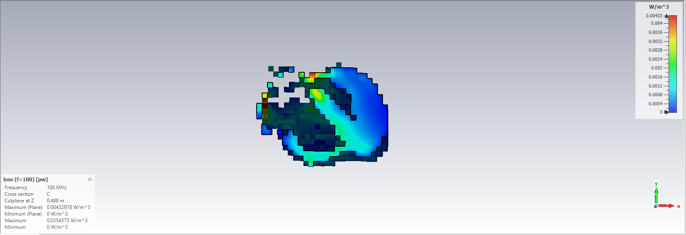
2-D SAR results for linear plane wave At angle 45
Fig. (20)

Slide 29
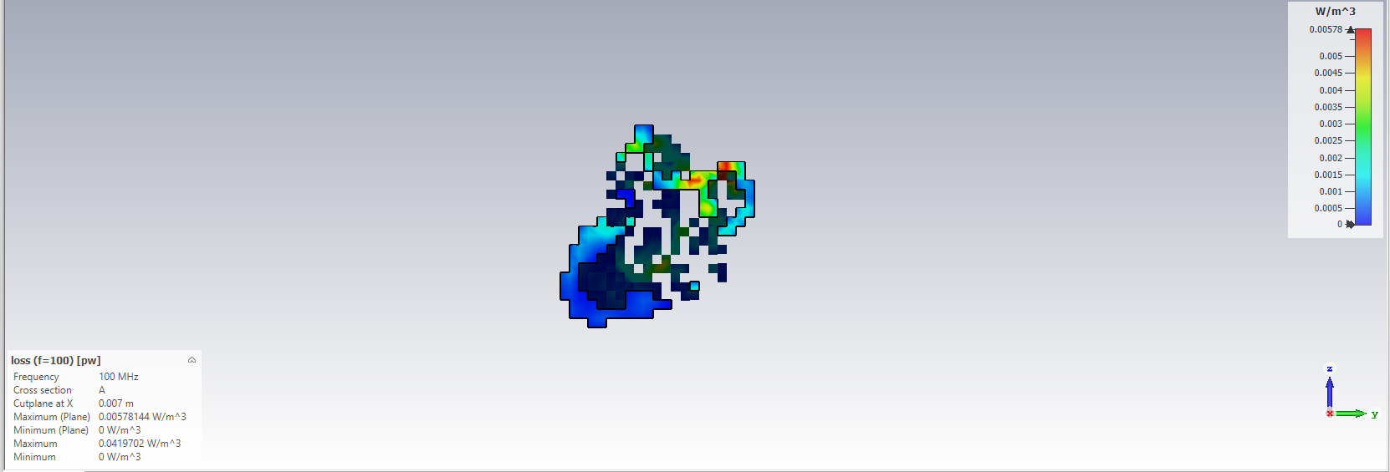
2-D SAR results for linear plane wave At angle 90
Fig. (21)

Slide 30
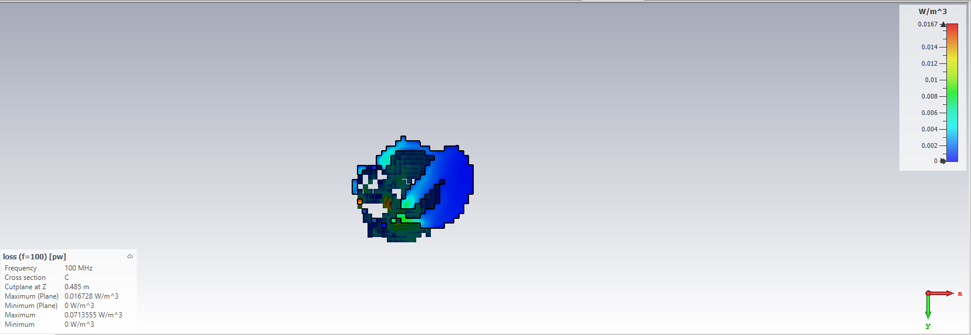
2-D SAR results for Circular plane wave At angle 0
Fig. (22)

Slide 31
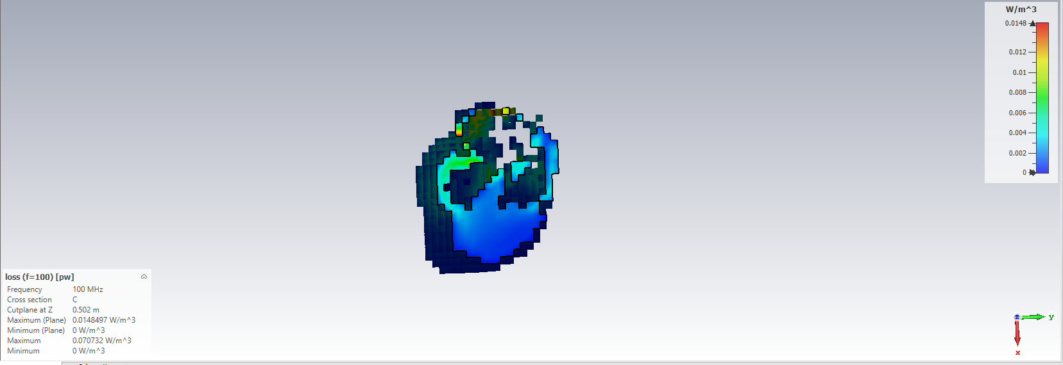
2-D SAR results for Circular plane wave At angle 45
Fig. (23)

Slide 32
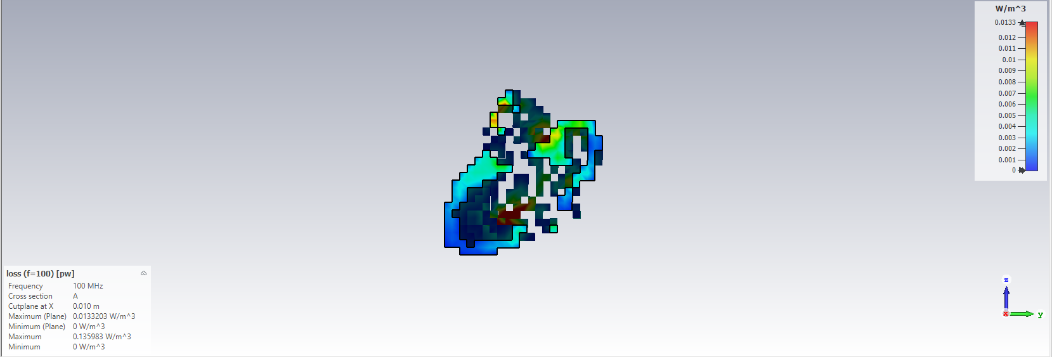
2-D SAR results for Circular plane wave At angle 90
Fig. (24)

Slide 33

2-D SAR results for Elliptical plane wave At angle 0
Fig. (25)

Slide 34
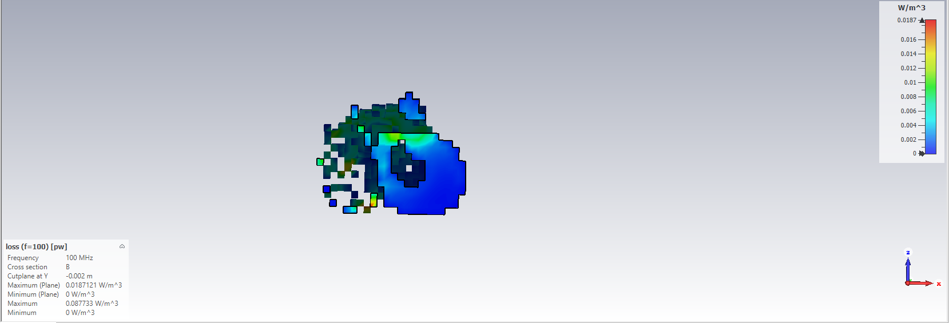
2-D SAR results for Elliptical plane wave At angle 45
Fig. (26)

Slide 35
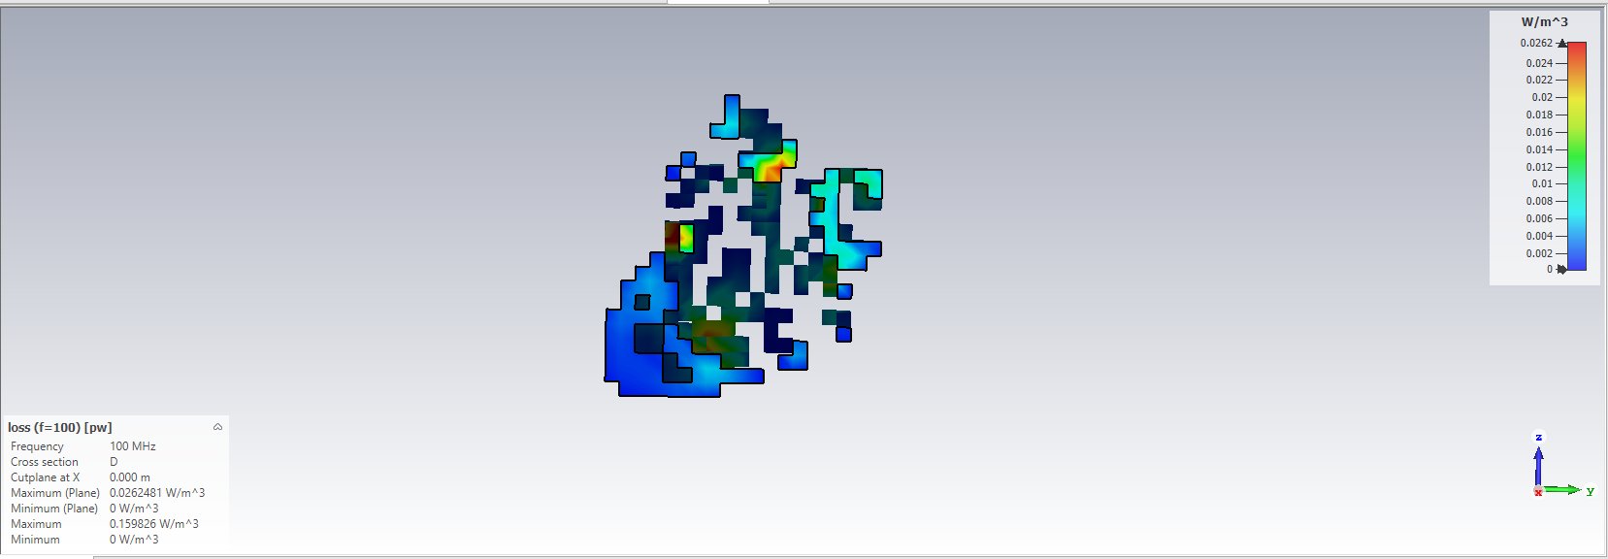
2-D SAR results for Elliptical plane wave At angle 90
Fig. (27)

Slide 36
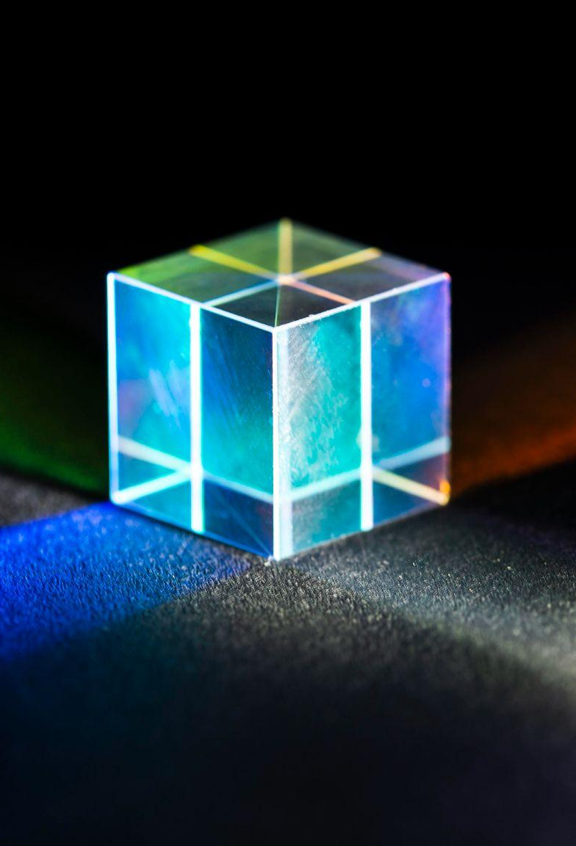
05. E-Field Animation

Slide 37
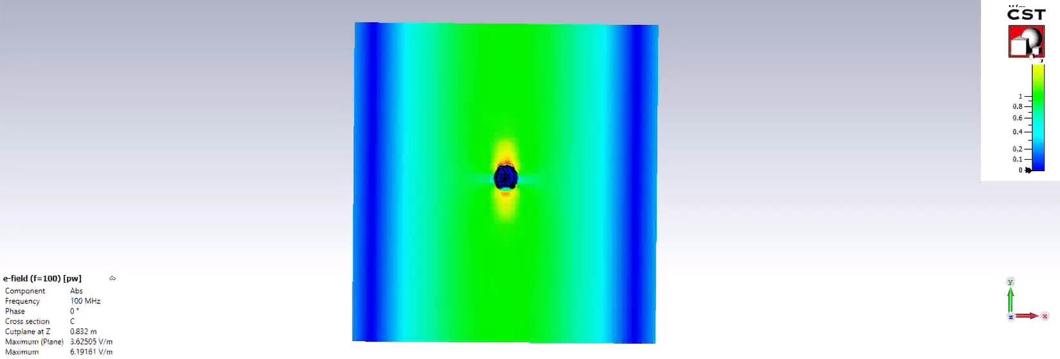
Brain angle 0

Slide 38
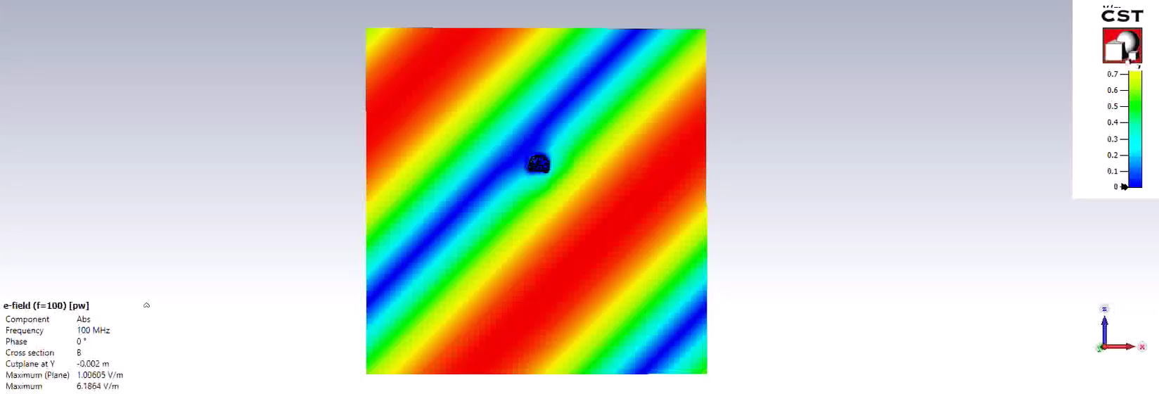
Brain angle 45

Slide 39
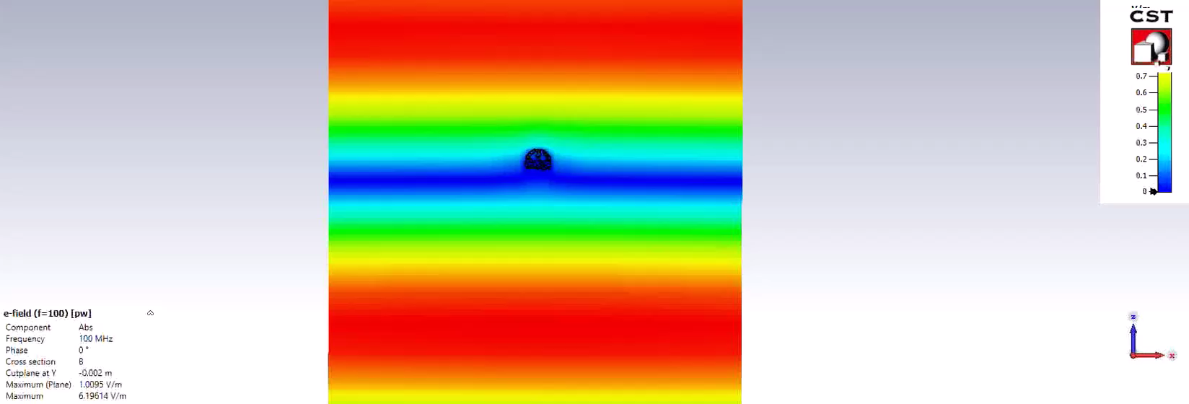
Brain angle 90

Slide 40
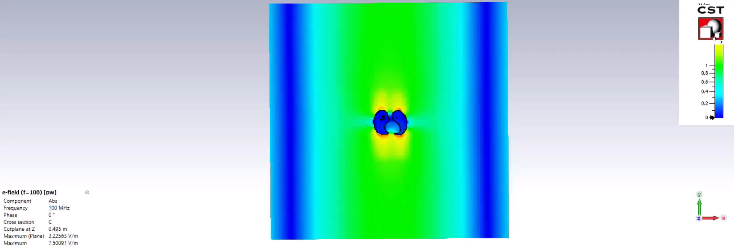
Lungs angle 0

Slide 41
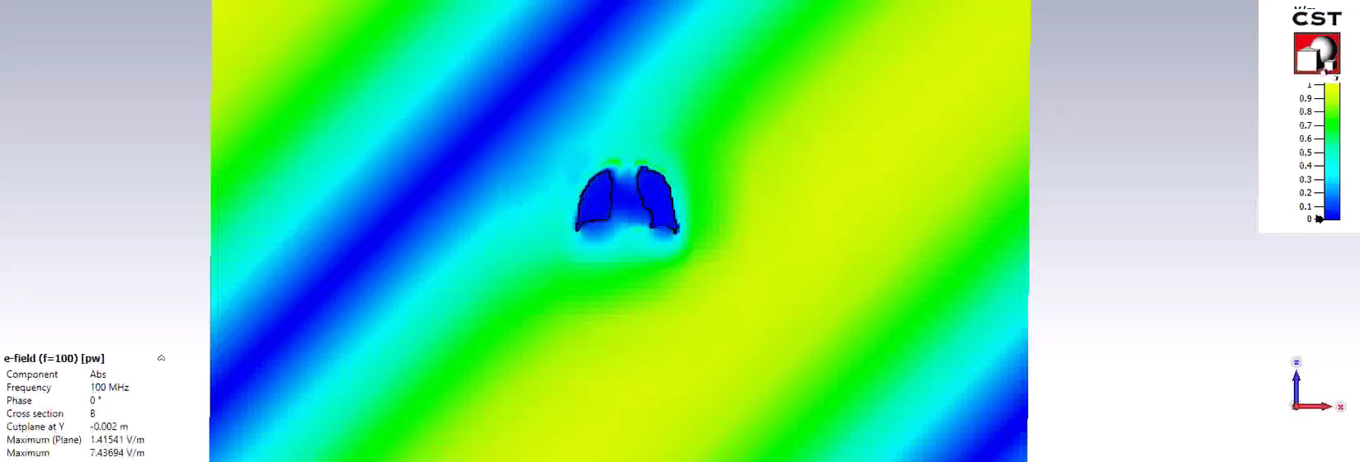
Lungs angle 45

Slide 42
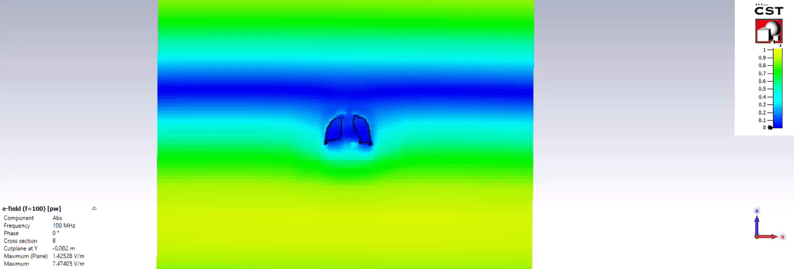
Lungs angle 90

Slide 43
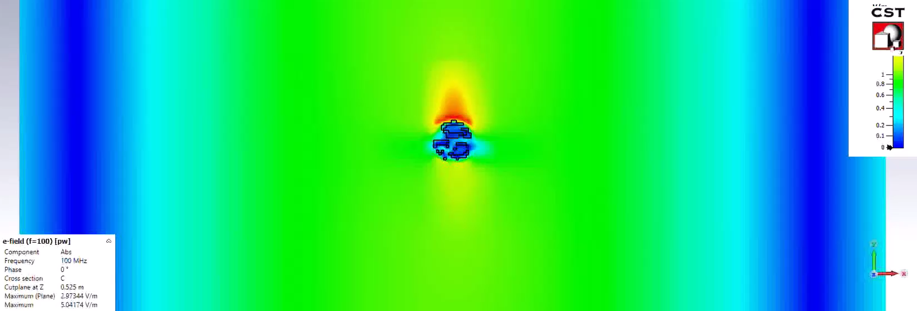
Heart angle 0

Slide 44
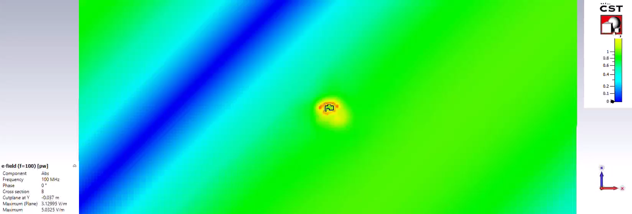
Heart angle 45

Slide 45
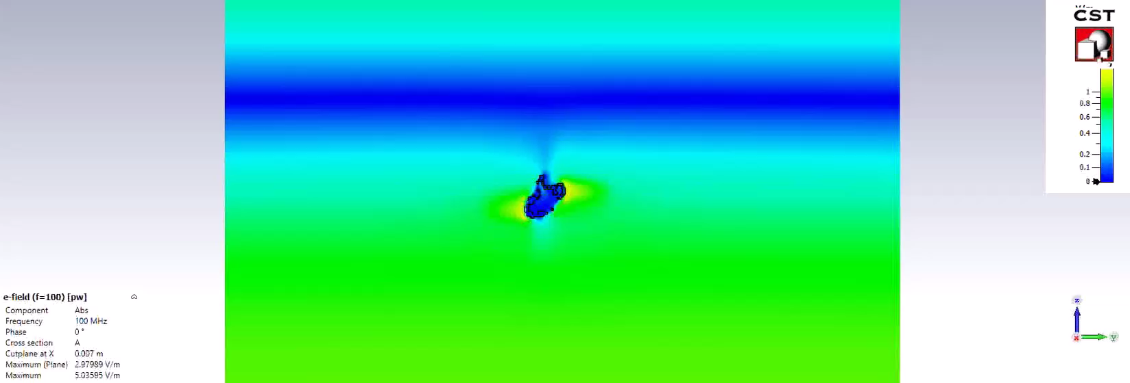
Heart angle 90

Slide 46
06. Project factors

Slide 47
Frequency of operation is 100 MHz
CST Body model is Hugo 5 mm

Slide 48
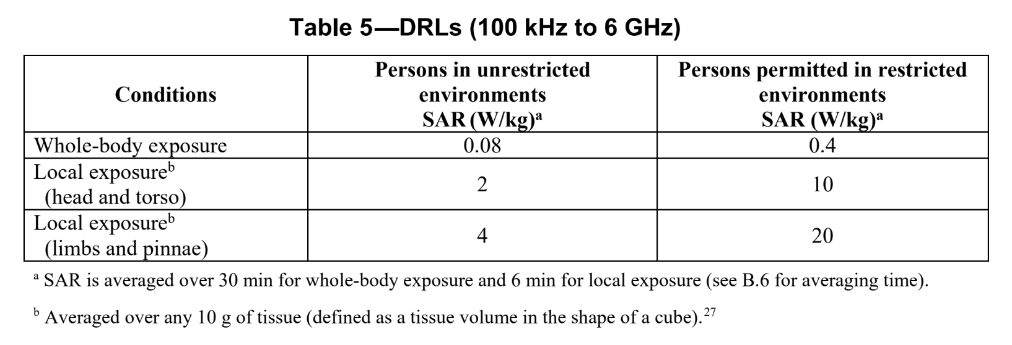
Standard used for comparing with IEEE standard

Slide 49
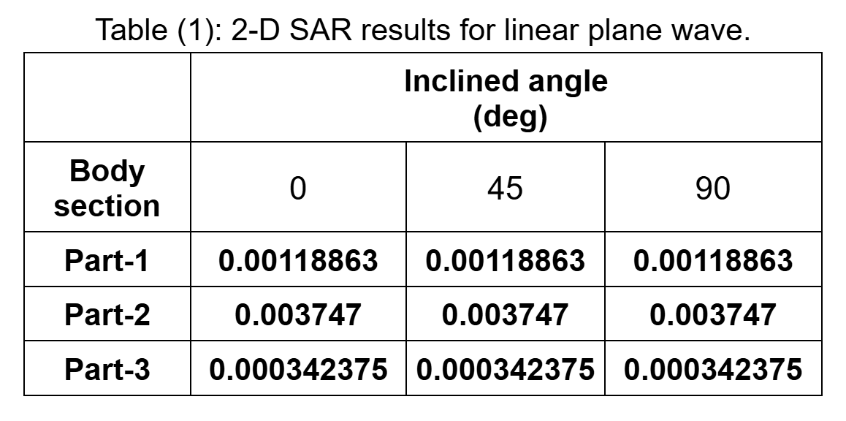

Slide 50
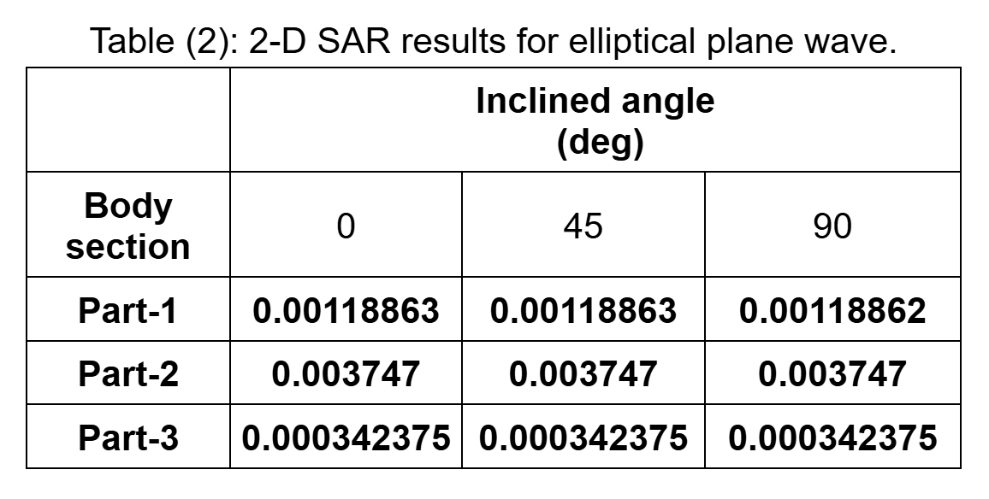

Slide 51
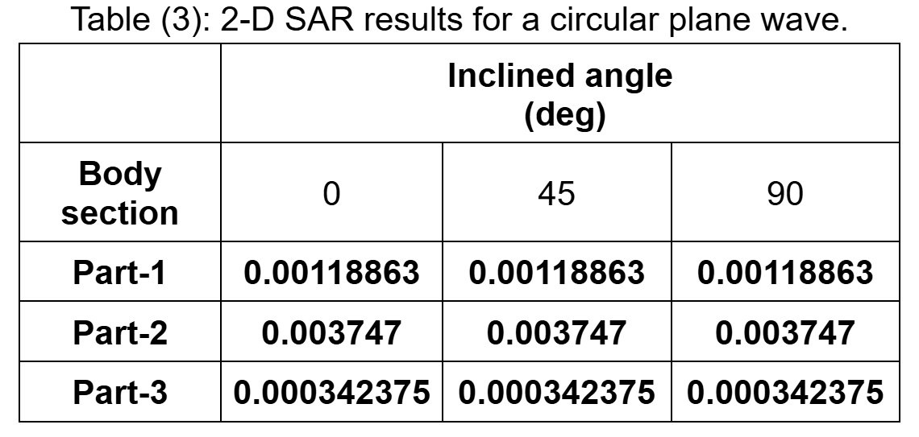

Slide 52
Thanks!
Do you have any questions?
☺
Made by:
Mariam Mostafa – Fatma Mamdouh – Mai Abdelnaby
202200570 – 202202095 – 202200504

